Slide 1
Making Faces: Conditional generation of faces using GANs via Keras+Tensorflow
Sophie Searcy

Slide 2
Who am I?

Slide 3
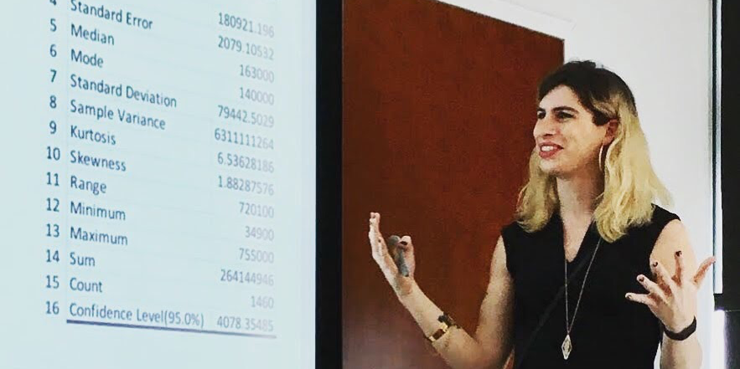

Who am I?
Sophie Searcy
Curriculum development lead and Data Science Instructor at Metis
Background: robotics, computational psychology
Current focus: Deep Learning and Data Science Ethics
Write and lead free workshops with t4tech

Slide 4
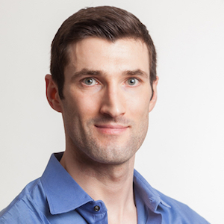

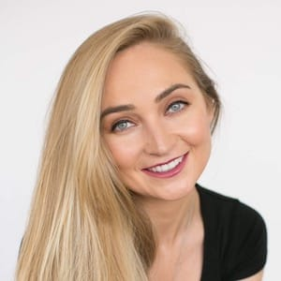
Who am I?
Metis thisismetis.com
Only accredited Data Science Bootcamp
Students changing careers into Data Science
Cohorts in Seattle, Chicago, San Francisco, and New York City
Corporate Training
Skill up your current team
Data Literacy, Big Data, Advanced Deep Learning topics
In-house Bootcamp-style training.
Mike Galvin
Kerstin Frailey

Slide 5
Signposting

Slide 6
Who is this for
Someone who
Understands and can explain the fundamentals of modern Deep Learning (there will be a review)
BackProp
Stochastic Gradient Descent
Common loss and activation functions
Has built models using a recent Deep Learning package (PyTorch, Theano, Keras, etc.)

Slide 7
What we’ll cover
Students should be able to:
Understand and explain the important components of Generative Adversarial Networks
Use provided boilerplate code and adapt it for new purposes
State of The Art techniques in GANs:
Students will be exposed to a few important, recent developments.
Students will have the building blocks needed to independently explore new techniques.

Slide 8
(rough) Agenda
Hour 1: Slides
Hour 2: Neural Net Theory notebook
Hour 3: GAN demo
Less instructional
Will provide hands-on help and take live-coding requests 😬
Workshop designed to be run on Google Colab for free.
All code distributed through GitHub and Colab.
All results acquired from Colab

Slide 9
Deep Learning Review

Slide 10
What makes deep Learning special?
Typical Machine Learning
Data
Transformations
Feature engineering, feature extraction
Tuned by hand, parameter search
Model
Linear model, SVM, RF, etc.
Optimized wrt objective function
Output

Slide 11
What makes deep Learning special?
Deep Learning
Data
Transformations
Deep Learning model
Optimized wrt objective function
Model
Output

Slide 12
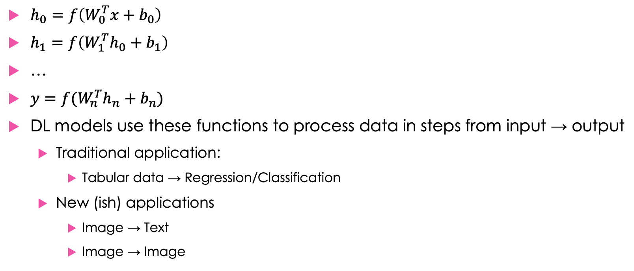
Essential parts: Differentiable functions
$h_{0}=f\left(W_{0}^{T}x+b_{0}\right)$
$h_{1}=f\left(W_{1}^{T}h_{0}+b_{1}\right)$
…
$y=f(W_{n}^{T}h_{n}+b_{n})$
DL models use these functions to process data in steps from input → output
Traditional application:
Tabular data → Regression/Classification
New (ish) applications
Image → Text
Image → Image
Notes:
Everyone here has likely been persuaded of the value of deep learning models. But we should review, why do they work so well?

Slide 13
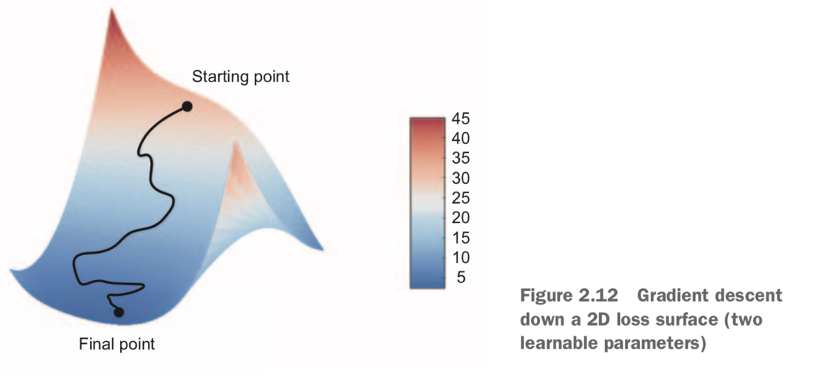
Essential parts: Stochastic Gradient Descent + BackProp
Gradient Descent
Finds adjustment to function parameters that minimizes the loss function
Back Propagation
Chain rule of calculus in algorithm form.
Applies gradient descent over many layers of a network.
Chollet 2018
Notes:
Everyone here has likely been persuaded of the value of deep learning models. But we should review, why do they work so well?

Slide 14
Deep Learning approach
Traditional Machine Learning
A lot of time spent engineering your data/features to find the best ones for a model to learn.
Train a shallow model to make predictions based on features.
Deep Learning
Time is spent on finding DL architecture that is able to learn the feature transformations it needs.
More time can be spent on improving/expanding dataset.
Train a model to find the best parameters for the entire pipeline from data -> prediction.
Notes:
Everyone here has likely been persuaded of the value of deep learning models. But we should review, why do they work so well?

Slide 15
GAN Overview

Slide 16
Convolutional Classifiers
Convolutions learn feature maps
Use sampling/pooling to summarize over height and width of image
Output is some classification vector, e.g. probabilities
source

Slide 17
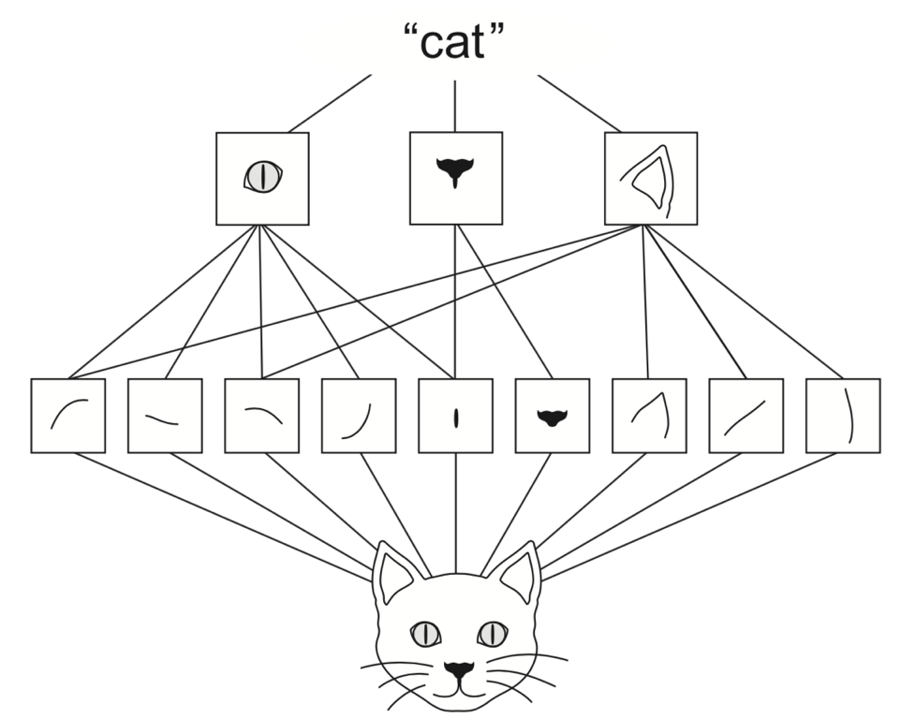
Convolutional filiters
Pixels → subparts → parts → whole
Chollet 2018

Slide 18
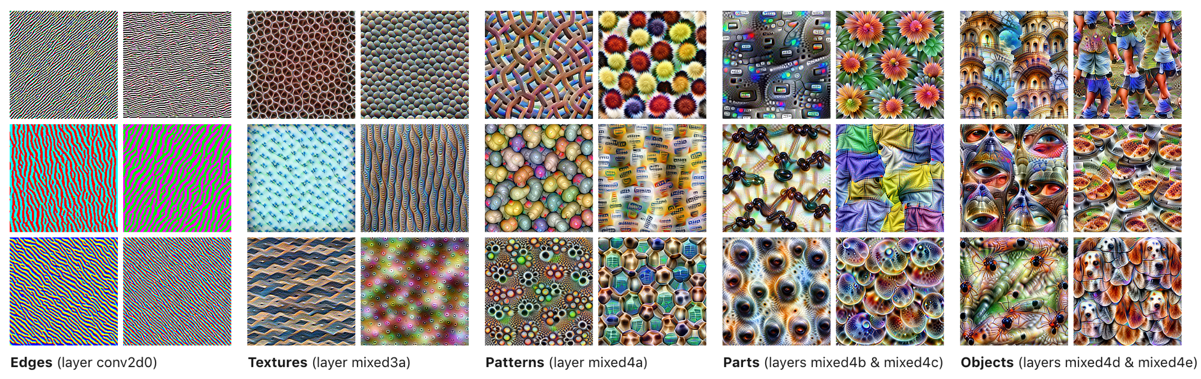
Convolutional filters
Pixels → subparts → parts → whole
We can visualize this progression by finding input that maximizes activity at layer
Olah 2017

Slide 19
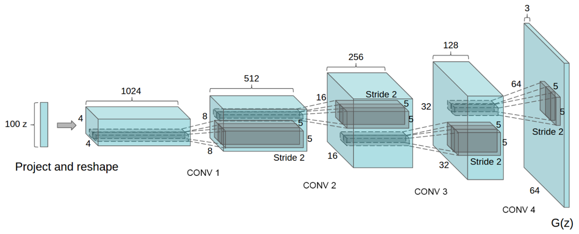
Convolutional Generation
Convolutions learn feature maps
Upsampling/DeConvolution progressively grow image
Radford et al 2015

Slide 20
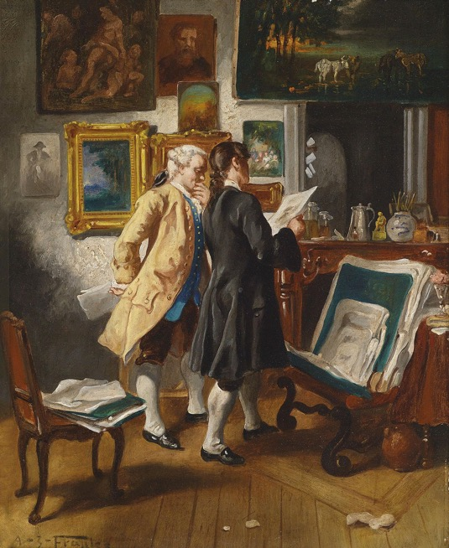
GAN Architecture
D(x) - Discriminator
Given image
Attempts to classify as fake or real

Slide 21
GAN Architecture
G(z) - Generator
Given random vector z
Attempts to generate an image that fools D(∙)

Slide 22
GAN Architecture
G(z) - Generator
Given random vector z
Attempts to generate an image that fools D(∙)
D(x) - Discriminator
Given image
Attempts to classify as fake or real

Slide 23
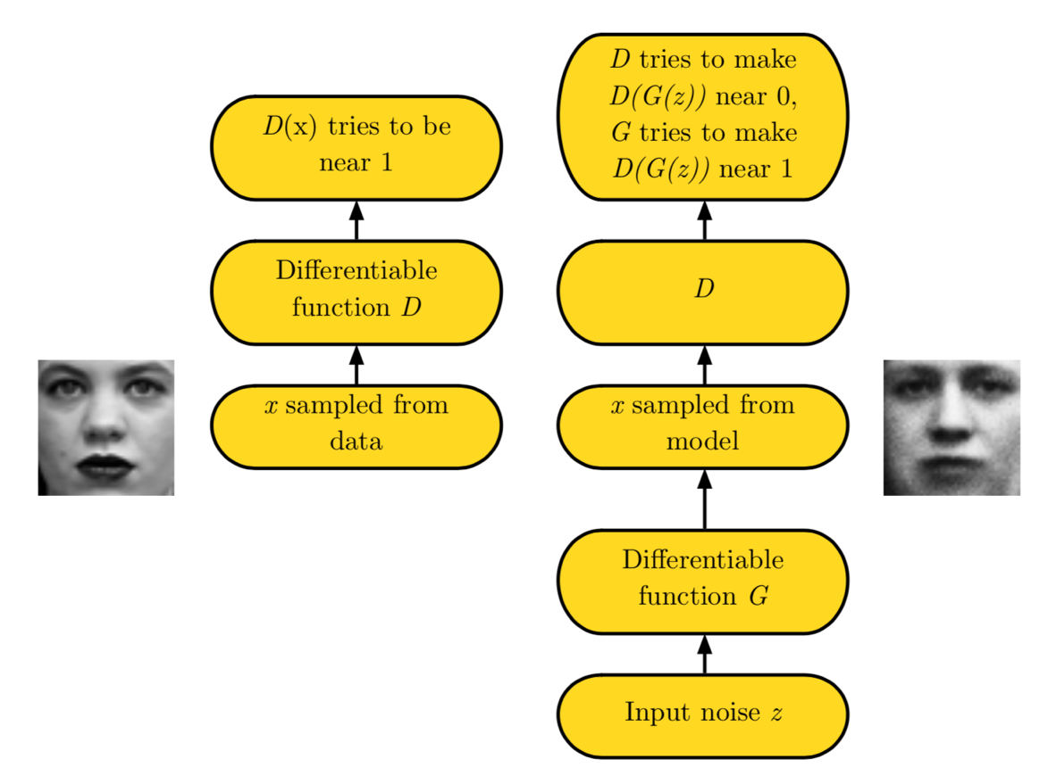
GAN Architecture
Goodfellow 2016

Slide 24
Generator task
G(z) - Generator
Given random vector z
Attempts to generate an image that fools D(∙)
Imagine you are the generator
CIFAR image data (32x32)
Generate a frog that will fool the discriminator

Slide 25
Generator task
You are the generator
Imagine you can see the training data.
You can learn as much as you want from the training data.
You have to devise a strategy to trick the Discriminator.
What is your strategy for fooling the discriminator?
i.e. what if you had to say/write pseudocode for the best strategy in a minute or so?

Slide 26
Generator task
What is your strategy?
Memorize training images?
You have ~ 1 million parameters but the training data has ~ 100 million pixels

Slide 27
Generator task
What is your strategy?
Memorize training images?
You have ~ 1 million parameters but the training data has ~ 100 million pixels
Instead the generator learns the distribution of the training data.
Attempts to generate an example from that distribution

Slide 28
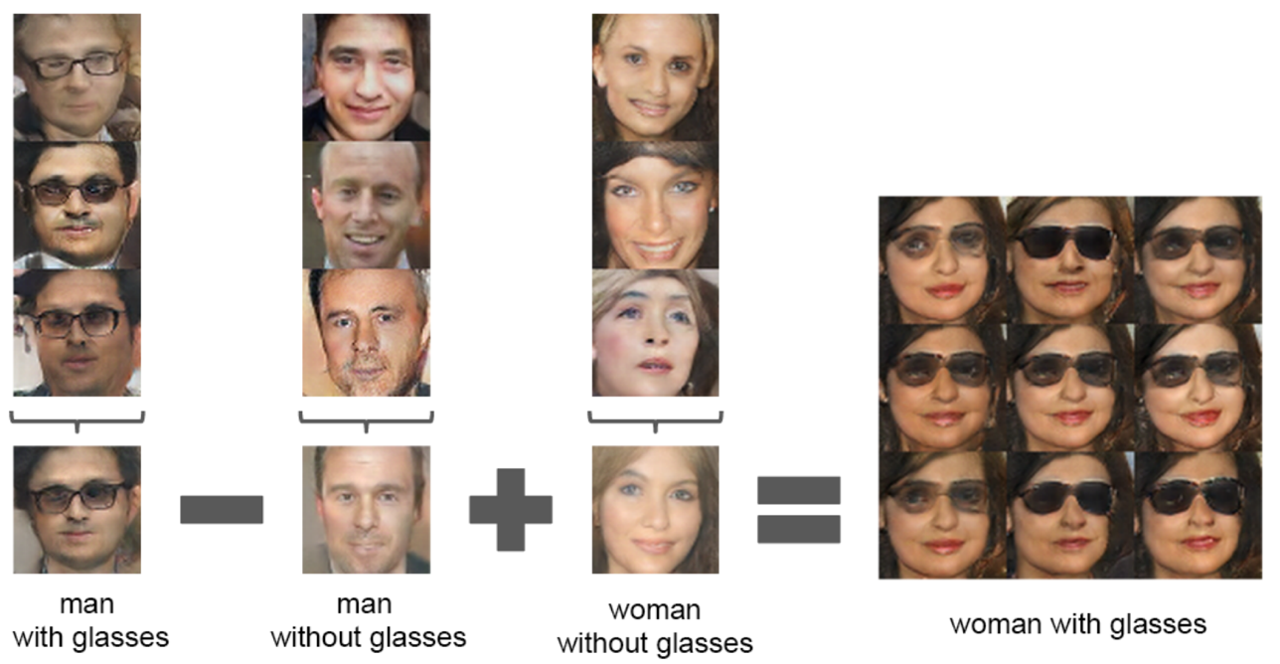
Distribution Learning
Generator learns distribution of training data
Meaningful understanding of that training data
Radford et al 2015

Slide 29
Advanced GAN Topics

Slide 30
Lipschitz Continuity
Problem: in many cases, the discriminator can be essentially impossible for the generator to beat.
Impossible to win → zero gradient → no learning
Lipschitz constant: Maximum rate of change of a function
Spectral Normalization (Miyato et al 2018) constrains the Lipshitz constant of the discriminator, ensuring stable training of generator.
source

Slide 31
Multilabel Conditional GAN

Slide 32
Classifier + GAN
Classes provide additional signal
both generator and discriminator learn data distribution more quickly
Significantly quicker learning (wall clock)
Allows direct manipulation of class feature in generator

Slide 33
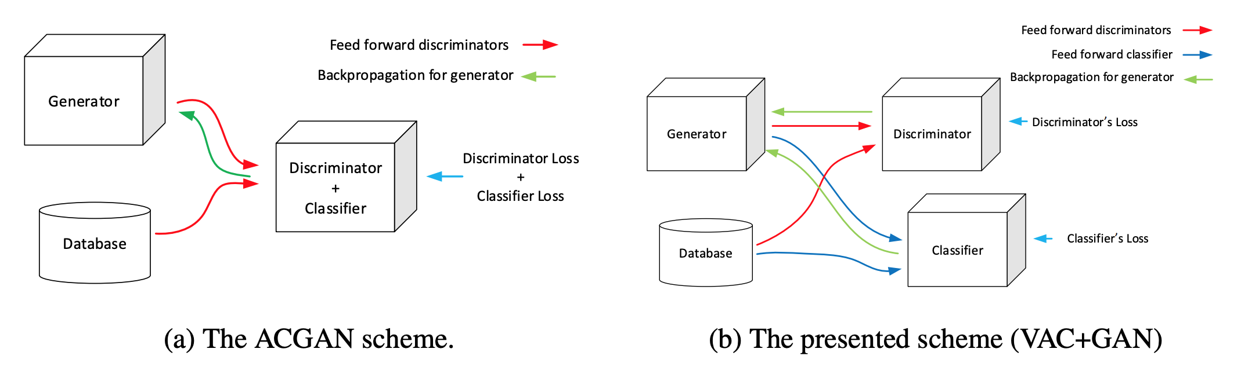
VAC GAN
Bazrafkan 2018

Slide 34
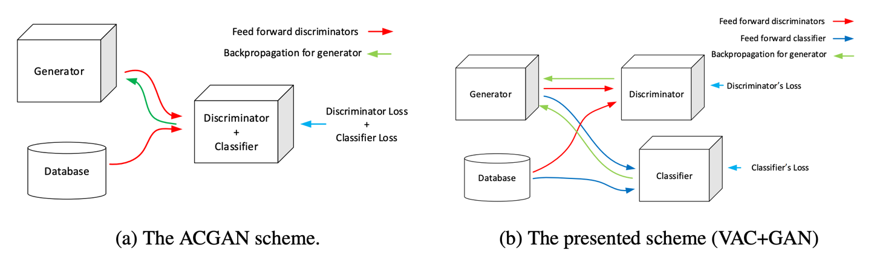
VAC GAN
VAC GAN
Good: Versatile classification with GAN
Bad: Requires a 3rd model
Today’s demo: VAC-GAN variant that combines Discriminator and Classifier
Bazrafkan 2018

Slide 35
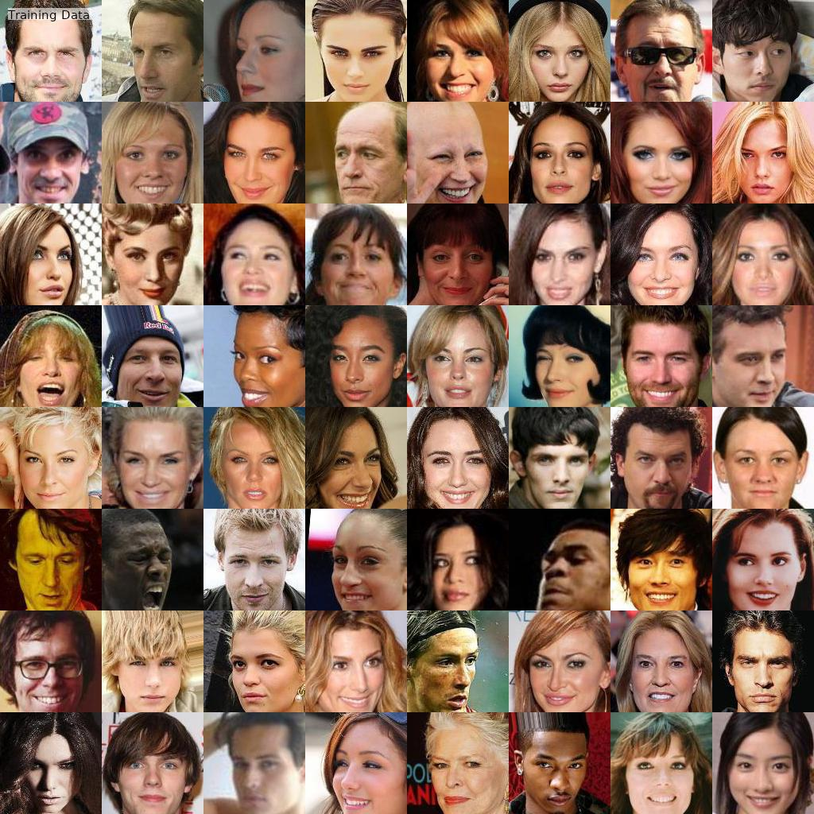
Results

Slide 36
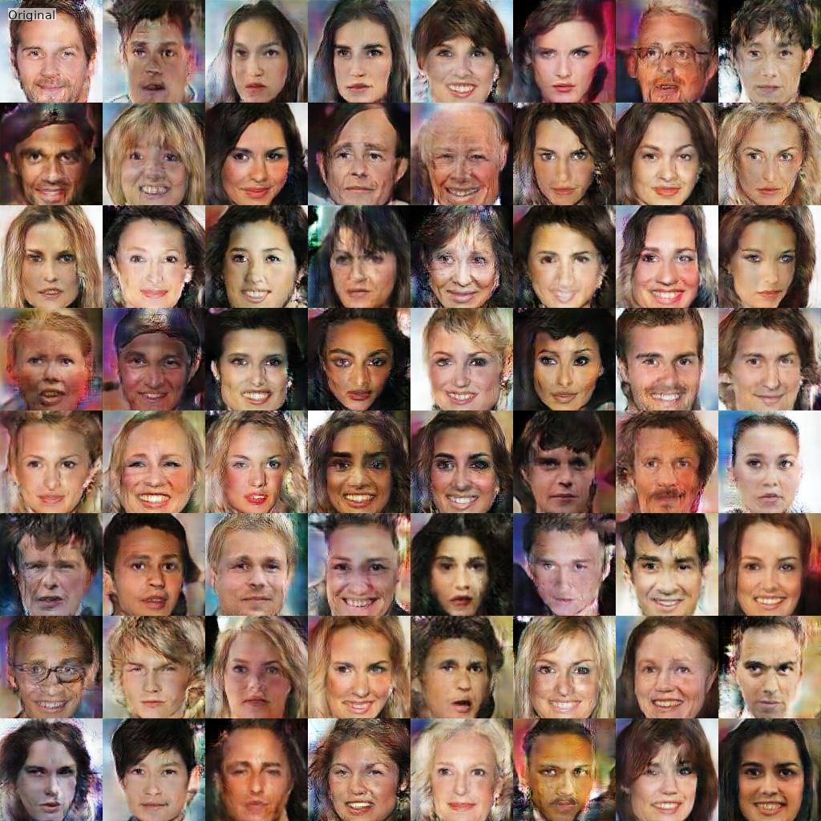
Results
Notes:
These results were generated on Google Colab (for free). You can, of course, get much better results with expensive hardware, but this is a good demo of how far you can go for free.

Slide 37

Results

Slide 38
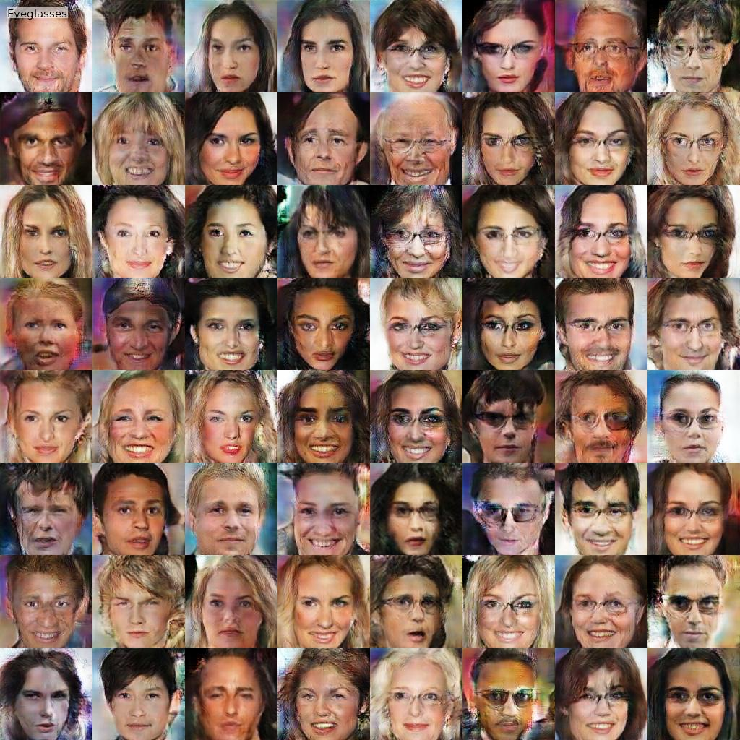
Results

Slide 39
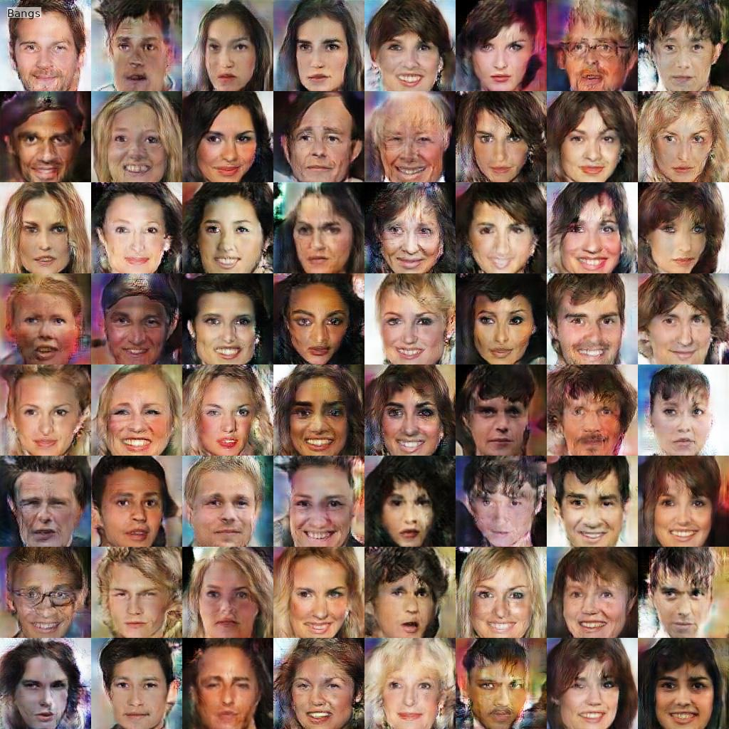
Results

